Slide 1

TurnUp
Team 12
Cosi Jackson
Connor Hudson
David Persico
Zhaojian Li
Yi Man
Daniel Trahan
Notes:
Everyone introduces - clear and concise

Slide 2
Vision and Market
Vision to create a new listening experience
Web based app
Machine learning
Personalized radio
Tailored playlists
Market of smart device users and music listeners
Notes:
1.5 min potentially?
rubric - Vision, product description, and product market are provided in a clear and understandable description.
TurnUp is a personalized web radio. Our goal was to create an application that is both a user friendly and personalized music player. To achieve this we implemented a machine learning algorithm that will generate playlists tailored to a user’s taste.
TurnUp with a market of smart device users that is continuously increasing, we’re sure people will find time to TurnUp.

Slide 3
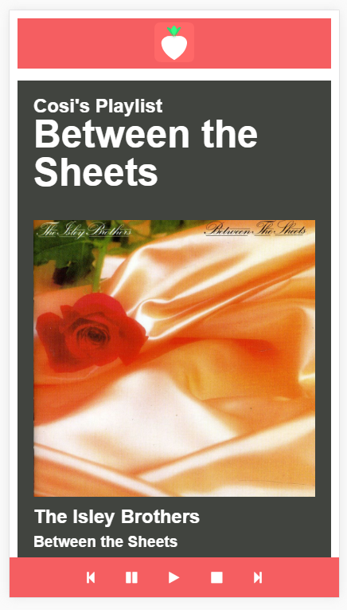
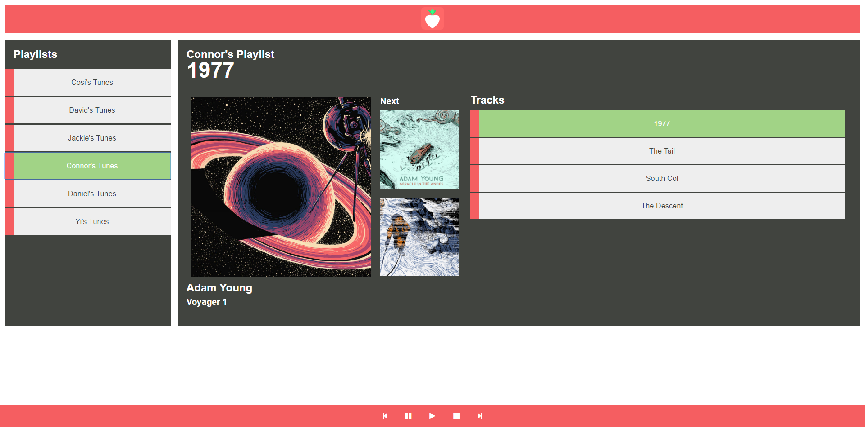
Screenshots
Notes:
TurnUp is a mobile friendly web app, you can use TurnUp on Android, Apple and also work on the pc.
On the left is the what TurnUp look like on a mobile, and on the right is how TurnUp work on pc

Slide 4
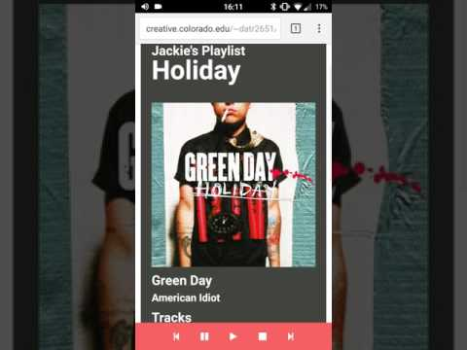
Demo
Notes:
Rubric - Product’s use, features, and behavior is well described and demonstrated.

Slide 5




Technical Details
Backend
Frontend
Notes:
Backend notes:
~0.75min
Node JS was performant and easy to implement SQL worked decently well - relational database - song info for training - hosted w. Microsoft azure
Restify - API framework Vowpal Wabbit Code Style Testing and Deployment

Slide 6






Development Tools
Notes:
~0.5 minutes

Slide 7
Problems & Solutions
Tensor Flow -（Magenta）
Minor front end design kinks
Finding places to host the site and backend was challenging
Change to Vowpal Wabbit
Team input, working with others
Utilized ATLAS Creative Cloud and GitHub to demo host the site.
Notes:
*** Also, not everything in rubric requirement needs to be listed in slide, but definitely talked about in presentation. Feel free to add notes like that below in “Click to add notes” ***

